Slide 1





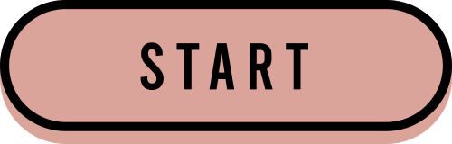

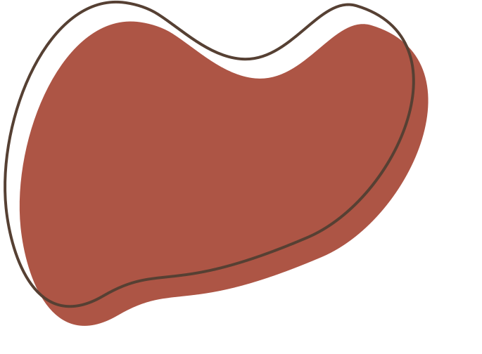
SCRABBLE PROJECT
Spencer, Cindy, Cody, Yumi, Jessica

Slide 2
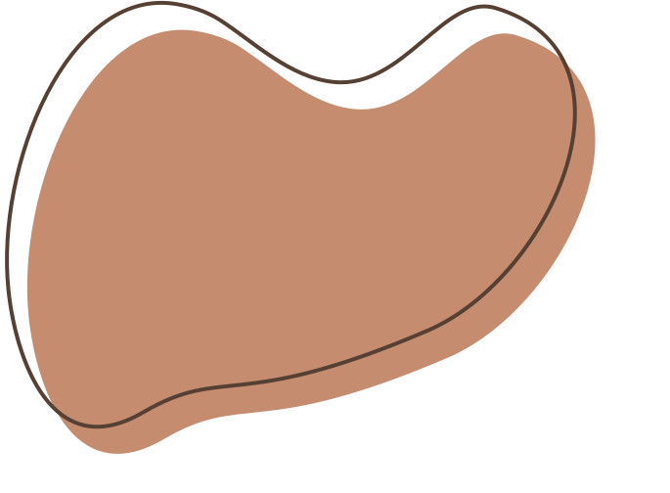


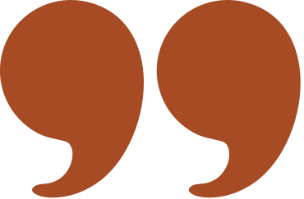




Agenda
Topic 1: Project Introduction
Topic 2: Solution Overview
Topic 3: Data Processing & Exploration
Topic 4: Technical Specifications & Analysis
Topic 5: Conclusion & Forward Thinking

Slide 3




Project Introduction
This project aims to predict the ratings of human players on Woogles.io in Scrabble games using metadata and gameplay data. With ~73,000 games played by bots and humans, the task is to train a model on one set of opponents to predict ratings for a different set in the test data. The dataset includes game metadata, turns data, and pre-game ratings. The objective is to forecast player ratings in the test set before the respective games were played.

Slide 4


Solution Overview
1.
2.
3.
4.
Data Processing
Transform Turn and game level datasets
Create Train and test dataset
Visualization
Explore the hidden patterns in the Turn data
Feature Engineering
Generate new
aggregated features and rolling averages
Predictive Model
Feature importance ranking
Test out different models and choose the best one

Slide 5

Data Overview
Game Data:
game_id
first
time_control_name
game_end_reason
winner
created_at
lexicon
initial_time_seconds
increment_seconds
rating_mode
max_overtime_minutes
game_duration_seconds
Turn Data:
game_id
turn_number
nickname
rack
location
move
points
score
turn_type
As part of this competition we were given game level data for 72,773 games, and for each of those games we had turn level data, for a total of 2,005,498 turns.
Notes:
The first thing we noticed is that we need more informative features at the turn level

Slide 6

Data Processing
Tiles Placed Feature:
Created 'tiles_placed' to show the number of letters used from a player's rack per turn.
Difficult Letters Count:
Established 'difficult_letters' to count specific letter usage (Z, Q, J, X, K, V, Y, W, G).
Word Placement Orientation:
Included a feature to identify word orientation as vertical or horizontal.
One Hot Encoding for Turn Type:
Transformed 'turn_type' (6 categories: Challenge, End, Exchange, Pass, Play, Six-Zero Rule) into individual columns.
Points per Tile Placed:
Calculated this feature by dividing turn points by the number of letters used from the rack.
One Hot Encoding for Points Percentile:
Grouped turns into 10% point score percentiles for comparison against all dataset turns.
Step 1:
Generating More Features from Turn Level Data

Slide 7
Data Processing
Points Metrics:
Calculate mean, max, variance, and min of points.
Turn Metrics:
Count the total number of turns per player.
Take the maximum score achieved.
Turn Type Analysis:
For each turn type, compute:
Sum (total occurrences).
Mean (average occurrence rate).
Tiles Placement Metrics:
Calculate mean, max, variance, and min for tiles placed.
Difficult Letters Analysis:
Compute sum and mean for difficult letters.
Percentile Category Analysis:
Take the sum and mean for each percentile category.
Horizontal Placement:
Calculate sum and mean for horizontal placement.
Step 2: Aggregating Turn Level Data
Split Data:
Separate bots and human players into two distinct datasets.
Group by 'game_id':

Slide 8
Data Processing
Convert the following attributes into dummy variables:
time_control_name with 4 levels:
Blitz, Rapid, Regular, and Ultrablitz
game_end_reason with 4 levels:
Consecutive Zeros, Resigned, Standard, and Time
lexicon with 4 levels:
CSW21, ECWL, NSWL20, and NWL20
rating_mode with 2 levels:
Casual and Rated
bot_name with 3 levels:
BetterBot, HastyBot, and STEEBot
Feature Creation:
Create individual features for each time unit:
Month, Day, Hour, Minute, Second
Step 3: Game Level Data Conversion
Combine user and bot level turn data into one row for each game.
Merge this combined dataset with the game level data.

Slide 9
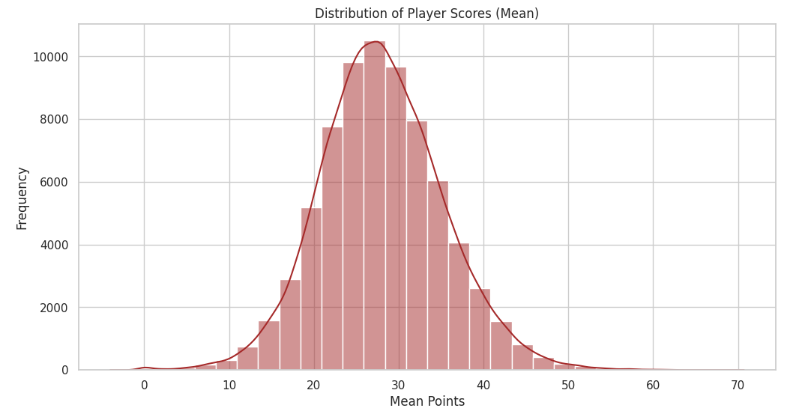
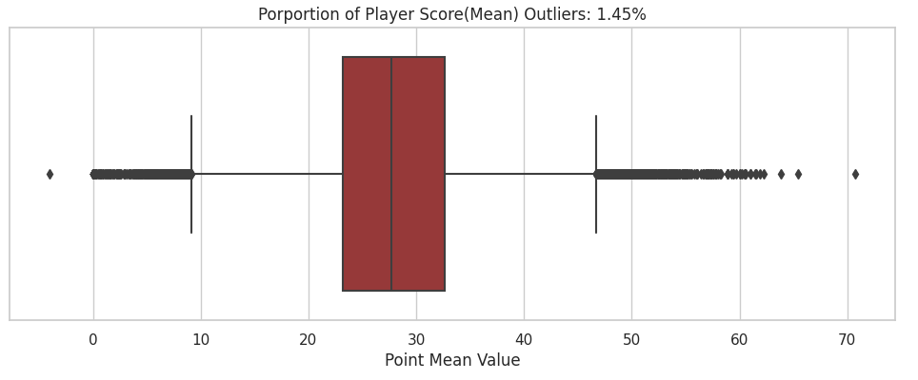
Exploration
Distribution of Player Scores(Mean)
normal distribution
Proportion of Player Score(Mean) Outliers: 1.93%
Numbers of outliers: 1,944
Numbers of non-outliers: 98,876

Slide 10
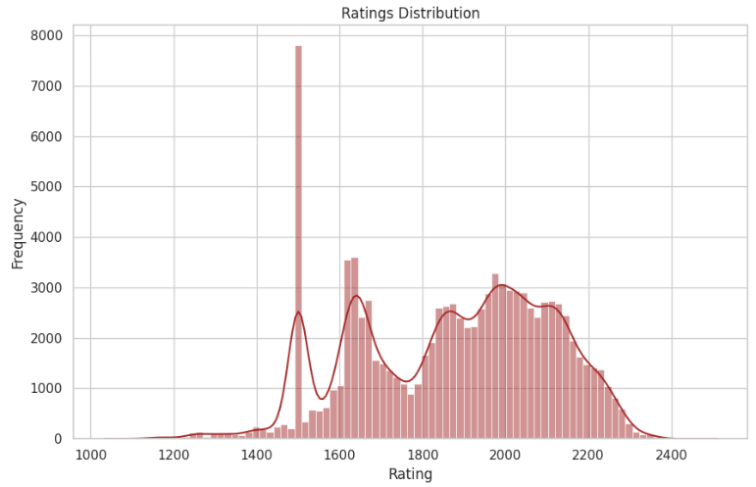
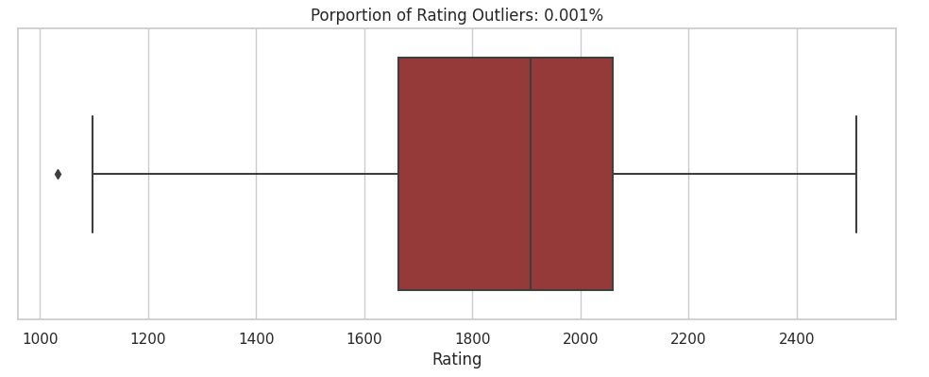
Exploration
Distribution of Ratings
Most Ratings are 1,500
Default rating for first game
Proportion of Rating Outliers: 0.001%
Highly Centralized

Slide 11
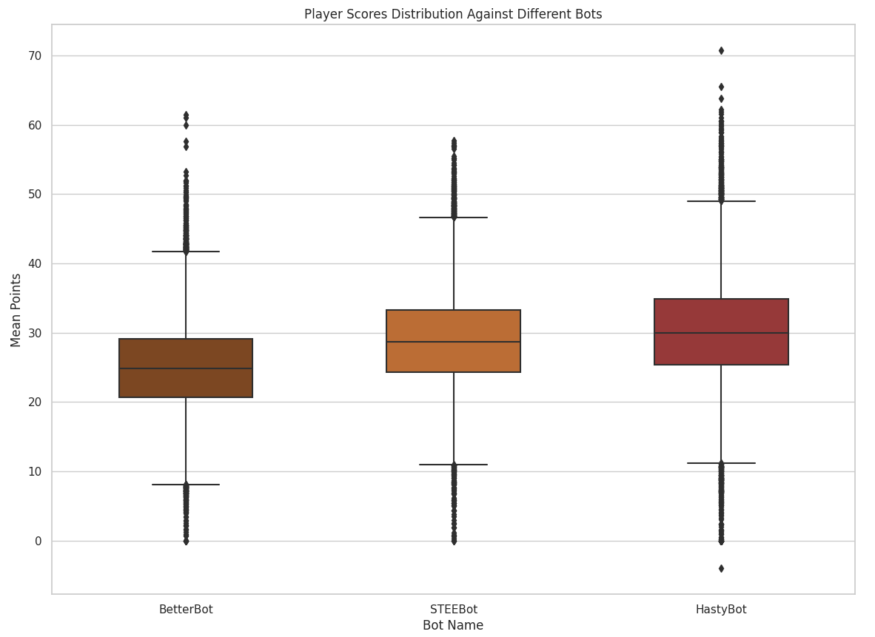
Exploration
Play Scores Distribution Against Different Bots
Highest: HastyBot
Medium: STEEBot
Lowest: BetterBot

Slide 12
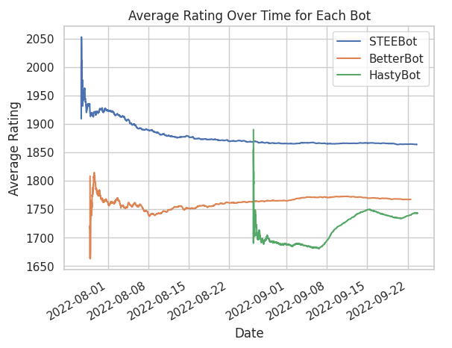
Exploration
Average Rating Over Time For Each Bot
Highest: STEEBot
Medium: BetterBot
Lowest: STEEBot
Notes:
Both the SteeBot and BetterBot seem to stay consistent over time, but the Hasty Bot fluctuates a little bit more

Slide 13
Feature Engineering
Rolling Average of the last 3 games played by the user
Rolling Average of the last 10 games played by the user
Feature Generation Strategy:
Based on players' past game performances.
Applied to every numerical column created during the data processing phase except the 'game_id' column.
542 total features
Rolling Average of all the previous games played by the user up until that point in time for the range given in the data set.
Then, since the first entry for each user did not have any previous games we used KNN Imputation to fill the NA values for the rolling averages

Slide 14
Feature Importance
1
2
3
4
5
.
Moving average of all previous games of the maximum score for a turn
Moving average over last 3 games of the proportion of games using lexicon_CSW21
Moving average of all previous games scores
Whether the current game is lexicon_CSW21
Moving average of the average points per turn of all previous games

Slide 15
1
Modeling
XGBoost
RMSE: 98.757
Time to Run: 46.6 minutes
We used RMSE (Root Mean Squared Error) to compare the models performance:
A larger RMSE means there's more variation in the prediction versus the reality
A smaller RMSE means your prediction is closer to the reality
2
LightGBM
RMSE: 99.58
Time to Run: 7.6 minutes
3
Random Forest
RMSE: 103
Time to Run: 1hr
Note: Time calculated from local computing environment with an Intel® Core™ i7 processor, 8GB of RAM, and a 64-bit operating system

Slide 16
Model Tuning Strategy - XGBoost
Hyperparameters
Avoid Overfitting
Hyperparameter Tuning
max_depth
gamma
min_child_weight
subsample
colsample_bytree
learning_rate
alpha
lambda
Cross Validation
Validate model against 5 unique data subsets
Take average RMSE across each subset to estimate performance
Bayesian Optimization
Efficiently navigates wider range for hyperparameters
Notes:
if we have time, we can dig into the hyperparameters of the best model.

Slide 17
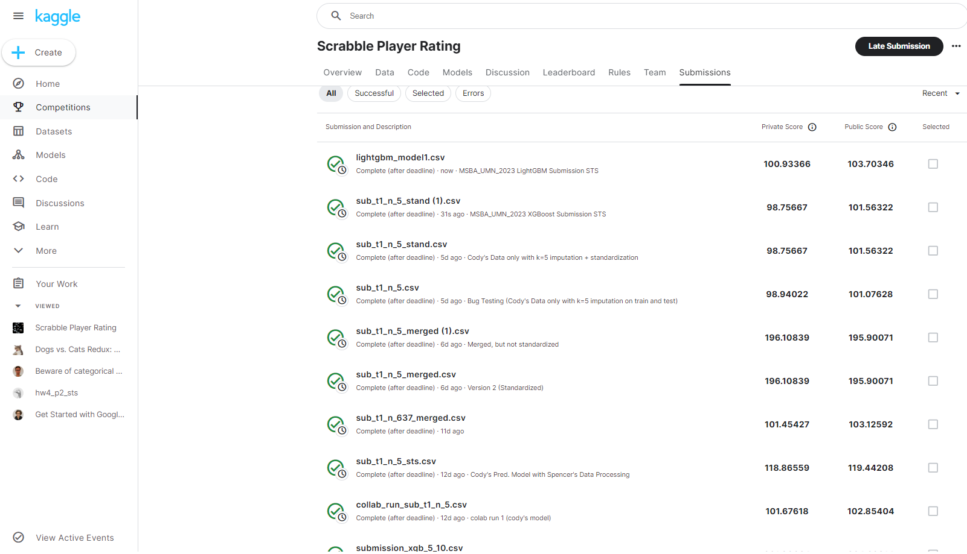
Result

Slide 18


Conclusion
Feature Importance:
Analyze feature importance provided by each model to understand which factors have the most significant impact on predicting performance ratings and Identify key features that strongly influence a player's performance in Scrabble.
Model Comparison:
Compare the performance of XGBoost, LightGBM, and Random Forest models to get the best fit model for prediction.
Notes:
Implement in-game assistance features based on the models. For instance, provide real-time hints, challenges, or tutorials tailored to a player's predicted skill level to enhance their gaming experience.

Slide 19
Forward Thinking
Player Segmentation:
Identification of distinct player segments helps tailor marketing strategies, engagement initiatives and game features to specific players preferences and skill levels
Dynamic Difficulty Adjustment:
Use the models to adapt the game difficulty in real-time based on a player's predicted skill level, ensuring a challenging but enjoyable experience.
In-Game Assistant:
Providing real-time hints and challenges to a player’s predicted skill level to enhance their gaming experience

Slide 20






Slide 21
Modeling
We use RMSE(Root Mean Squared Error) to compare the models performance:
a bigger RMSE means there's more variation in the prediction and the reality
a smaller RMSE means your prediction is closer to the reality
1
2
3
XGBoost
LightGBM
Random Forest
Notes:
XGBoost
LightGBM
Random Forest

Slide 22




Agenda
TBD
updated on the second page

Slide 23
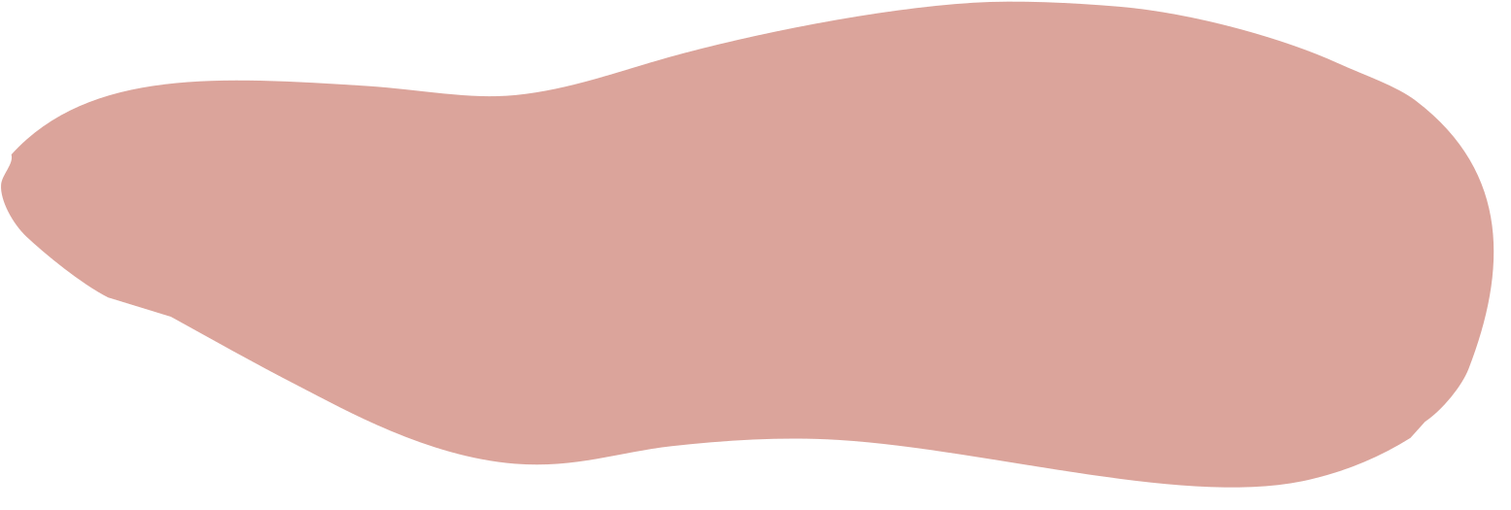


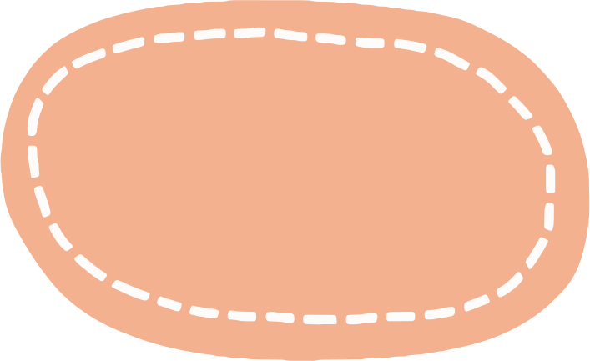


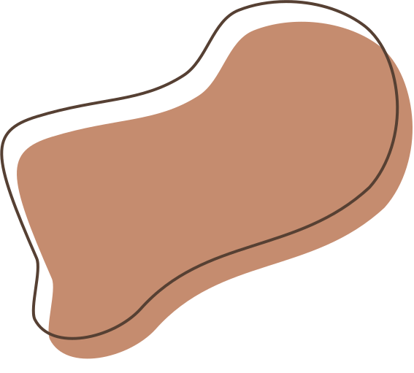
Question Time

